Slide 1
Multiscale Application Support in the MAPPER project Katarzyna Rycerz Department of Computer Science, AGH ACC Cyfronet, AGH http://dice.cyfronet.pl/
25.11.2013

Slide 2
Department of Computer Science & Cyfronet team
Marian Bubak
Eryk Ciepiela
Tomasz Gubała
Włodzimierz Funika
Marek Kasztelnik
Daniel Harężlak
Jan Meizner
Zofia Mosurska
Piotr Nowakowski
Maciej Pawlik
Robert Pająk
Bartosz Wilk

Slide 3
Multiscale Simulations
Consists of modules of different scale
Examples – e.g. modelling:
Physiological processes
Atomic fusion process
Irrigation canals
Nanomaterials
and many more ...
the reoccurrence of stenosis, a narrowing of a blood vessel, leading to restricted blood flow

Slide 4
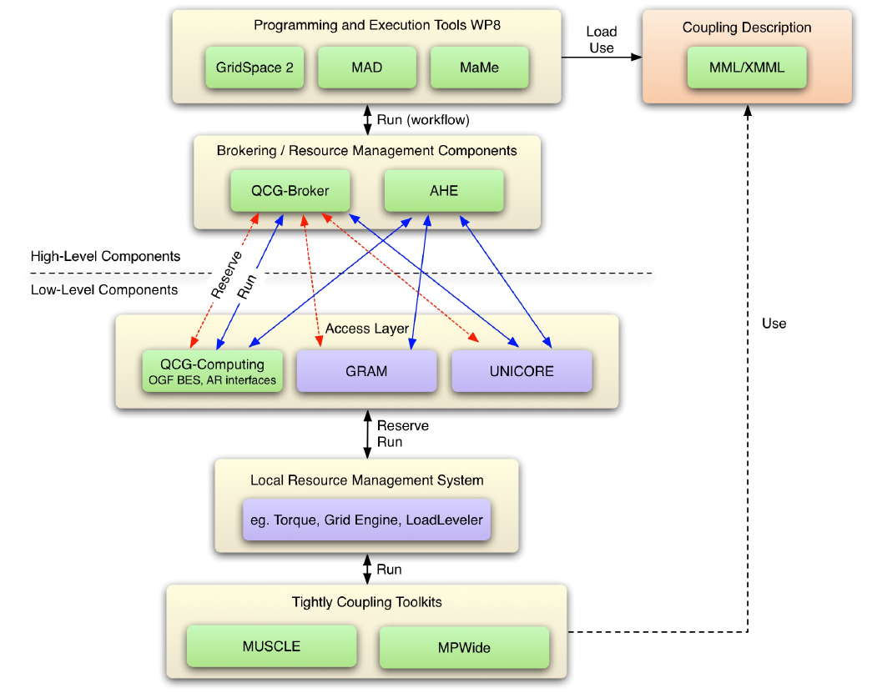
Objectives
Design and implement an environment for composing multiscale simulations from single scale models
encapsulated as scientific software components
distributed in various European e-Infrastructures
supporting loosely coupled and tightly coupled paradigm
Support composition of simulation models:
using scripting approach
by reusable “in-silico” experiments
Allow interaction between software components from different e-Infrastructures in a hybrid way.
Measure efficiency of the tools developed

Slide 5
Requirements
Support description of multiscale applications in an uniform way to
support building different multiscale applications from the same modules („lego”-based approach, reusability)
support switching between different versions of the modules with the same scale and functionality
Support computationally intensive simulation modules
requiring HPC or Grid resources,
often implemented as parallel programs
Support tight (with loop), loose (without loop) or hybrid connection modes

Slide 6
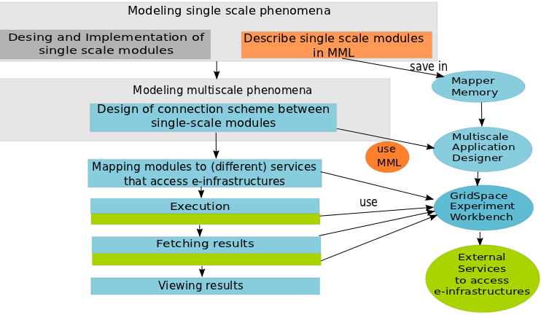
Building and Executing Multiscale Application
Process of constructing multiscale application consists of different steps
Most of these steps can be facilitated by:
common Multiscale Description Language (MML) - orange
programming and execution tools - blue
services accessing e-infrastructure - green

Slide 7
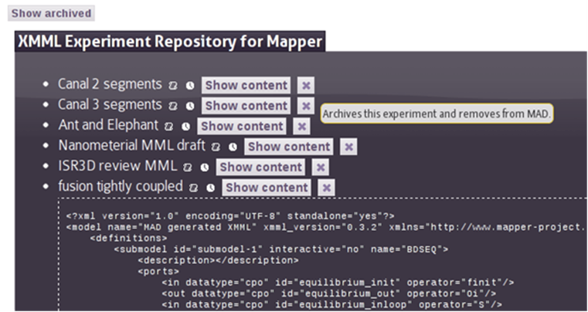
MAPPER Memory (MaMe)
Semantics-aware persistence store
Records MML-based metadata about models and scales
Supports exchanging and reusing MML metadata for
other MAPPER tools via REST interface
human users within theConsortium via dedicated Web interface
Available online at
http://gs2.mapper-project.eu/mame

Slide 8
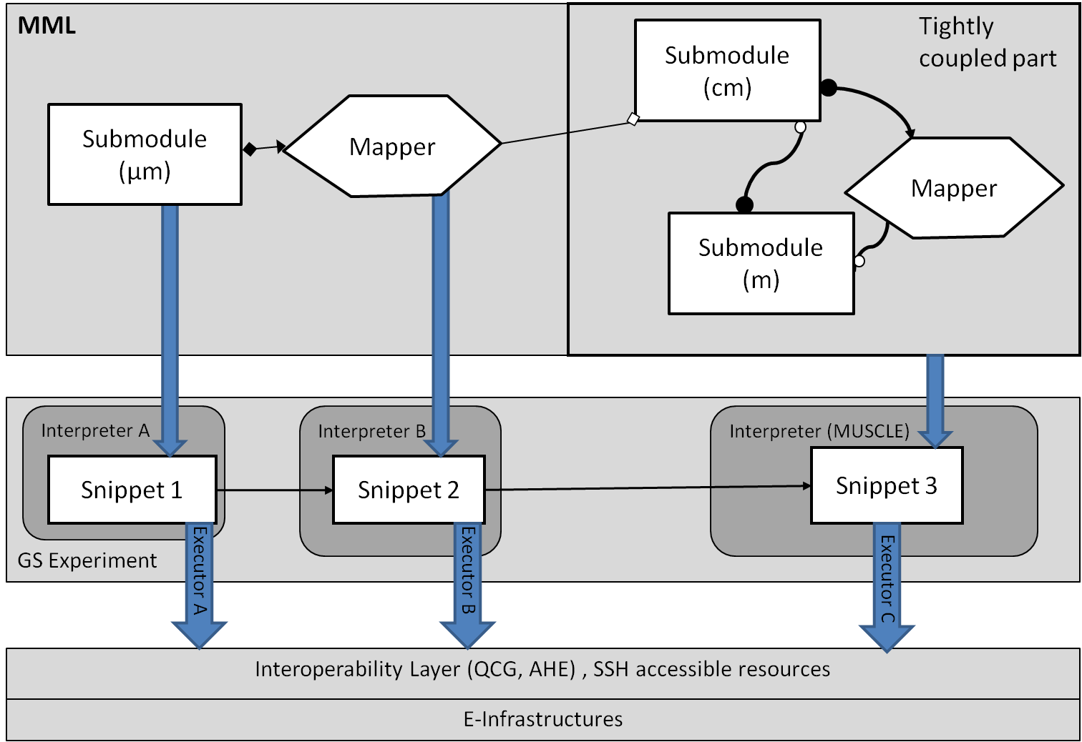
Multiscale Application Designer (MAD)
Supports composing multiscale applications from submodels and mappers registered in MaMe
Inport/export coupling topology represented in gMML to/from XMML file
Transforms high level MML description into executable experiment for GridSpace Experiment Workbench
Available at:
https://gs2.mapper-project.eu/mad
MAD

Slide 9
GridSpace Experiment Workbench (EW)
Supports execution and result management of infrastructure independent experiments
Experiment - application composed of code fragments called snippets, expressed in:
general-purpose scripting programming languages(Bash, Ruby, Perl etc.)
domain-specific languages (CxA in MUSCLE, Large-scale Atomic/Molecular Massively Parallel Simulator (LAMMPS), Car-Parrinello Molecular Dynamics (CPMD), Matlab etc.)
Snippets are evaluated by respective programs called interpreters
Executors- responsible for snippets execution on various computational resources – servers, clusters, grid via direct SSH or Interoperability layer (QCG, AHE)
Each snippet of the same experiment can be executed on different resource
Available at
https://gs2.mapper-project.eu/ew

Slide 10


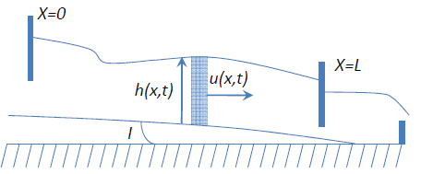
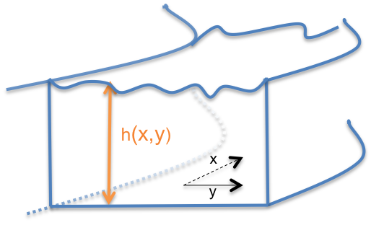



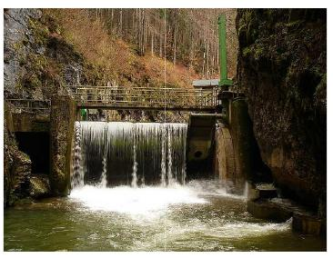
Case study: Irrigation Canal Application
coupling
LB models for long canal reaches .
LB-Shallow Water 1D
The water height varies with respect to X and Y.
LB-Shallow water 2D
coupling
coupling
LB-Free Surface 3D
- Flow around gates/transport of sediments
It requires supercomputing capabilities
taken from: Pham van Thang et al. Journal of Computational Physics,229(19) :7373-7400, 2010.

Slide 11
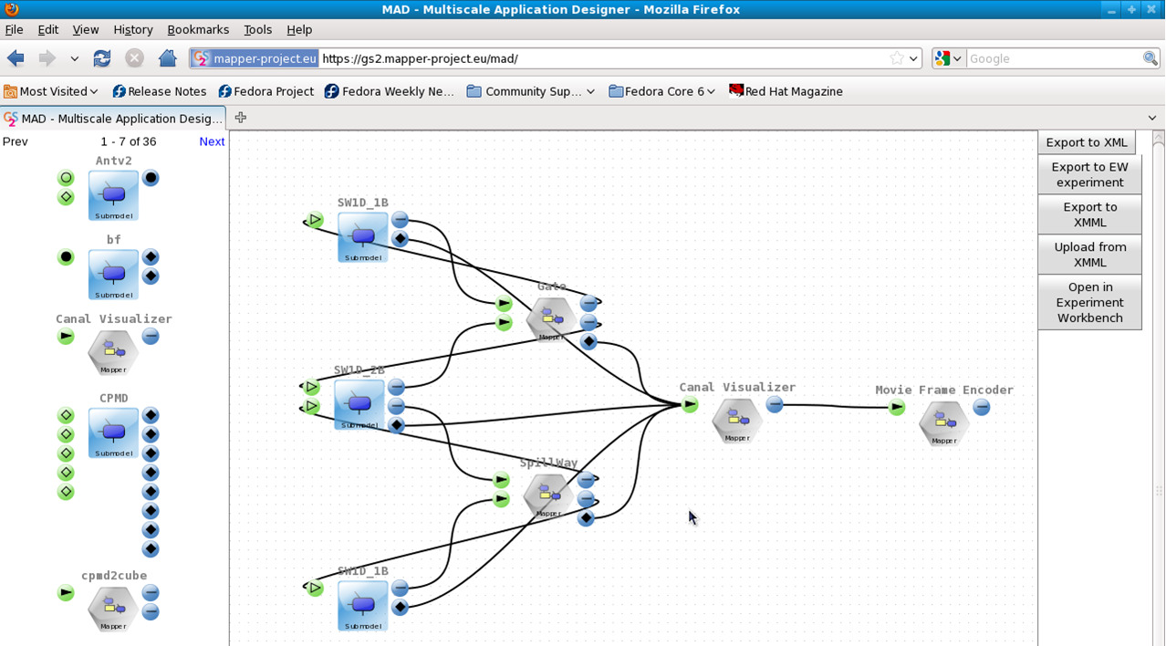
Irrigarion Canal Application in Multiscale Application Designer (MAD)

Slide 12
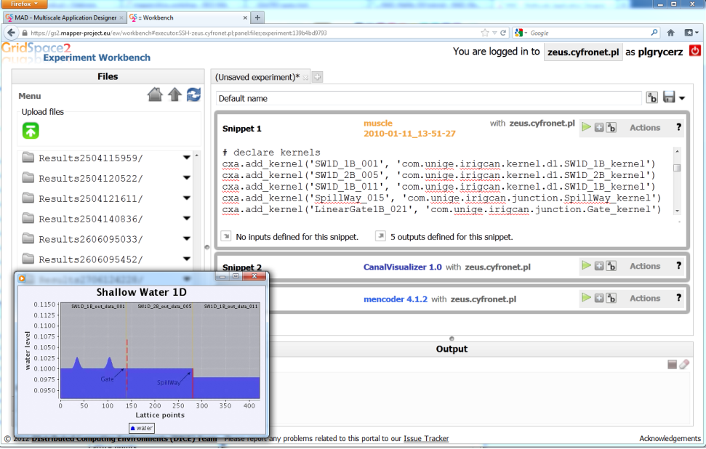
Canal Application in Experiment Workbench

Slide 13
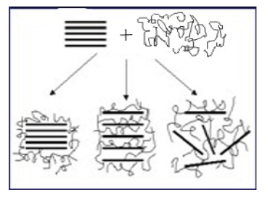
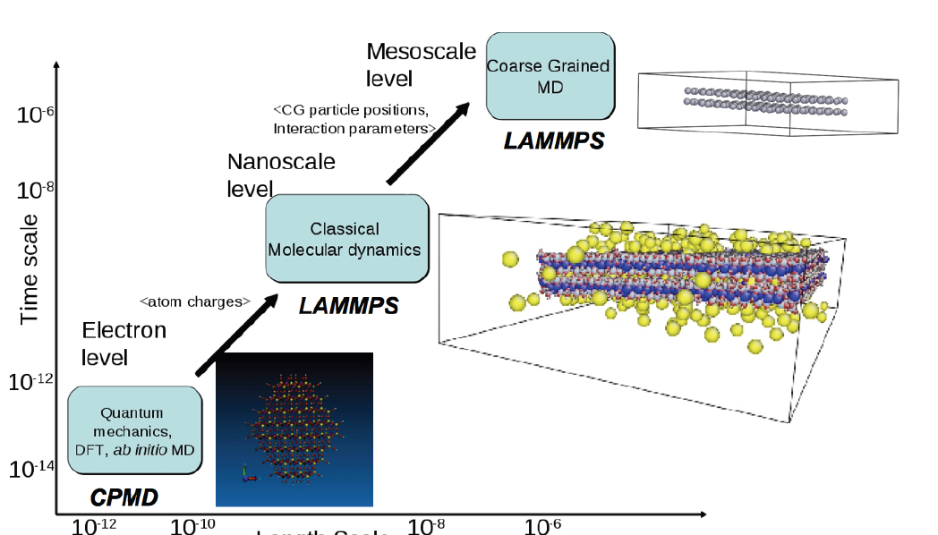
Case study – Nanopolymer simulation
Multiscale modeling of clay-polymer nanocomposites
useful for energy (oil industry additives), materials (nano composite materials) or biomedical applications (e.g. drug delivery).
calculation of sheet edge potentials: quantum mechanical solver CPMD
The hierarchical modelling of clay sheets in a polymer matrix over short time using atomistic MD approach (LAMMPS)
a coarse-grained MD for the larger scales (LAMMPS)

Slide 14
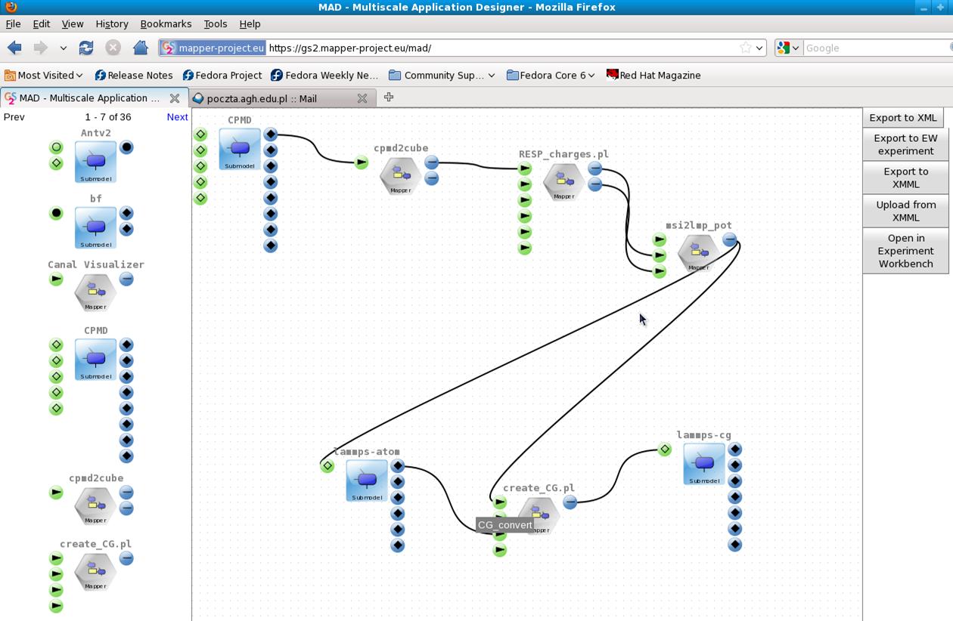
Nano Polymer Simulation in MAD

Slide 15
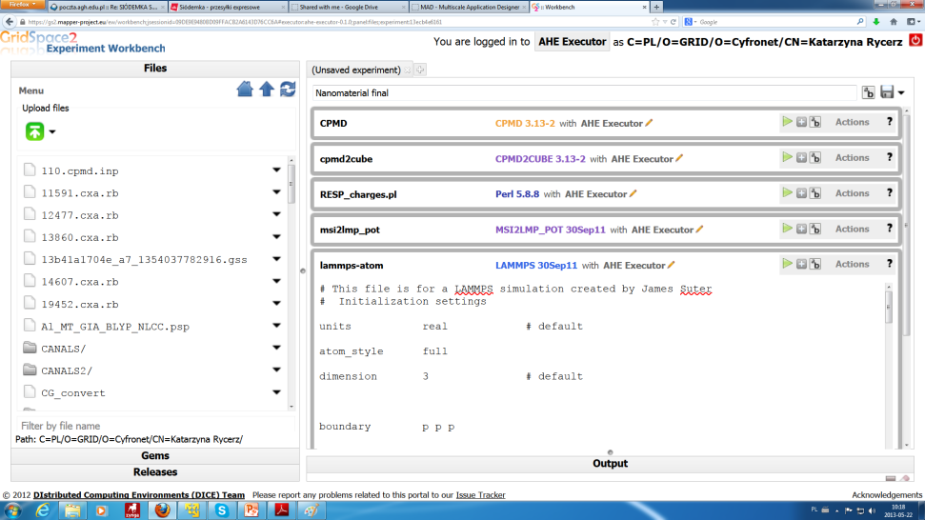
Nano Polymer Simulation in Experiment Workbench

Slide 16
Evaluation of efficiency
user experience with the MAPPER tools measured by feedback forms (SUS usability study) during seasonal MAPPER schools
All school participants learned tools basic in 1.5 h tutorial
“I think the system was easy to use”: 33% – fully agree (5/5 possible points), 47% – agree (4/5 points), 20% OK (3/5 points). There were no answers lower than 3 points
SUS score 70%
number of single-scale models incorporated and used within MAPPER infrastructure
45 submodels, 42 mappers
number of new scientific results from applications created by MAPPER tools measured by number of publications in well recognized journals/conferences
9 papers on using tools with the MAPPER applications,
3 papers on the tools,
11 tools demos and presentations.
3 posters on the tools
1 poster on using external metallurgical application

Slide 17
Scientific Results
A method and an environment for composing multiscale applications from single scale models
Validation of the the method against real applications structure by using tools
Extension of application composition techniques implemented in GridSpace to multiscale simulations
Support for multisite execution of multiscale simulations
Proof of concept for transforming high level formal description to actual execution using e-infrastructures
Notes:
MB - sugestie

Slide 18
Publications (1/2)
K. Rycerz, M. Bubak, E. Ciepiela, D. Harezlak, T. Gubala, J. Meizner, M. Pawlik: Composing, Execution and Sharing of Multiscale Applications, submitted to Future Generation Computer Systems, after 1st review
T. Gubala, K. Prymula, P. Nowakowski, M. Bubak: Semantic Integration for Model-based Life Science Applications. In: SIMULTECH 2013 Proceedings of the 3rd International Conference on Simulation and Modeling Methodologies, Technologies and Applications, Reykjavik, Iceland 29 - 31 July, 2013, pp. 74-81 (accompanying poster) (2013)
W. Funika, M. Janczykowski, K. Jopek, M. Grzegorczyk: An Ontology-based Approach to Performance Monitoring of MUSCLE-bound Multi-scale Applications, Procedia Computer Science, Volume 18, 2013, pp. 1126-1135,
M. B. Belgacem, B. Chopard, J. Borgdorff, M. Mamoński, K. Rycerz, D. Harezlak: Distributed Multiscale Computations Using the MAPPER Framework, Procedia Computer Science, Volume 18, 2013, pp. 1106-1115,
K. Rycerz, E. Ciepiela, G. Dyk, D. Groen, T. Gubala, D. Harezlak, M. Pawlik, J. Suter, S. Zasada, P. Coveney, M. Bubak: Support for Multiscale Simulations with Molecular Dynamics, Procedia Computer Science, Volume 18, 2013, pp. 1116-1125, ISSN 1877-0509, DOI (2013)
WP8 Programming and Execution Tools after Year 2

Slide 19
Publications (1/2)
B. Bodziechowski, E. Ciepiela, M. Bubak: Assessment of Software Quality with Static Source Code Analysis: GridSpace2 Case Study, abstract for Cracow Grid Workshop 2012, 22-24 October 2012, Kraków, Poland (2012)
K. Rycerz, D. Harężlak, G. Dyk, E. Ciepiela, T. Gubała, J. Meizner, and M. Bubak: Programming and Execution of Multiscale Applications, abstract for Cracow Grid Workshop 2012, 22-24 October 2012, Kraków, Poland (2012)
J. Borgdorff, C. Bona-Casas, M. Mamonski, K. Kurowski, T. Piontek, B. Bosak, K. Rycerz, E. Ciepiela, T. Gubala, D. Harezlak, M. Bubak, E. Lorenz, A. G. Hoekstra: A Distributed Multiscale Computation of a Tightly Coupled Model Using the Multiscale Modeling Language. In: Procedia CS 9, pp. 596-605 (2012)
K. Rycerz and M. Bubak: Building and Running Collaborative Distributed Multiscale Applications. In: W. Dubitzky, K. Kurowsky, B. Schott (Eds) Large-Scale Computing Techniques for Complex System Simulations, Chapter 6, pp. 111-130. J. Wiley and Sons ( Dec 2011)
K. Rycerz, M. Nowak, P. Pierzchala, M. Bubak, E. Ciepiela and D. Harezlak: Comparision of Cloud and Local HPC approach for MUSCLE-based Multiscale Simulations. In Proceedings of The Seventh IEEE International Conference on e-Science Workshops, Stockholm, Sweden, 5-8 December 2011. IEEE Computer Society, Washington, DC, USA, 81-88 (2011)

Slide 20
MSC theses
Multiscale Applications Composition and Execution Tools Based on Simulation Models Description Languages and Coupling Libraries M.Nowak supervised by Katarzyna Rycerz; AGH University of Science and Technology, Krakow, Poland,(June 2012)
Assessment of Software Quality with Static Source Code Analysis: GridSpace2 Case Study, Bartłomiej Bodziechowski; Master of Science Thesis supervised by Marian Bubak; consulted by Eryk Ciepiela; AGH University of Science and Technology, Krakow, Poland, (September 2012)
Multiscale Applications in the Gridspace Virtual Laboratory, Paweł Pierzchała supervised by Katarzyna Rycerz; AGH University of Science and Technology, Krakow, Poland, (September 2012)
Optimization of Application Execution in Virtual Laboratory, Mikolaj Baranowski; Master of Science Thesis supervised by Marian Bubak; AGH University of Science and Technology, Krakow, Poland (2011)

Slide 21
Cooperation with external and local users
MAPPER tools are available to PL-Grid users
Collaboration with Dr Łukasz Rauch from Department of Applied Computer Science and Modelling AGH, Kraków
Collaboration with Olivier Hoenen and Dr David Coster from Max Planck Institute for Plasma Physics
MAPPER tools tutorial is used during the courses for students on subjects: „Computational Methods in Science” and „Large Scale Computing Systems”
GridSpace installation and deployment for the community of 3D object retrieval through CNR-IMATI institute in Genova

Slide 22
MAPPER Funding
Total | 336 000 euro
EC | 241 903 euro
MNiSzW | 94 097 euro
Cyfronet AGH contribution | 0
Overhead for Cyfronet AGH | 126 000 euro

Slide 23
Summary
We have designed and implemented an environment for composing and running multiscale simulations
The accessibility of web-based tools enables applications to be shared among scientists working in the same area
Tools are available to Kraków and Polish scientists
Multiscale simulations solutions’ integrated with possibilities given by environments for application composition and European e-Infrastructures (including PL-Grid)
Efficiency evaluation results show that the proposed approach is successful and that it can be used for multiscale applications in various research fields

Slide 24
MAPPER at ACC Cyfronet AGH - see
http://dice.cyfronet.pl/
Project publications, presentations and posters
Administrators manuals
Tutorials for end users
Demonstration videos from all meetings

Slide 25
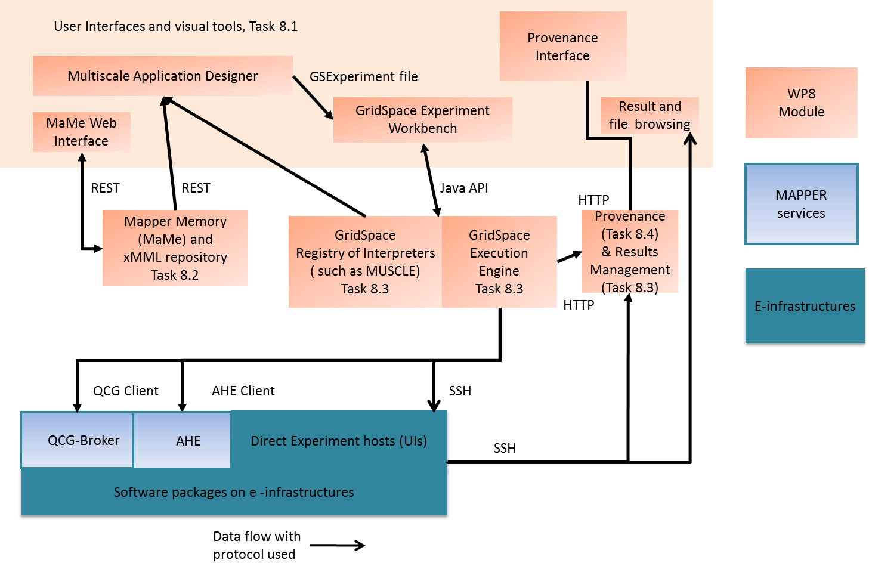
Overview of the Tools
WP8 Programming and Execution Tools after Year 3

Slide 26
Cooperation with external users
Summer School on Grid and Cloud Workflows and Gateways, 1-6 July 2013, Budapest,
MAPPER tools are intruduced to PL-Grid users
http://www.plgrid.pl/en
Collaboration with Dr Łukasz Rauch from Department of Applied Computer Science and Modelling AGH, Kraków
Results of using WP8 tools for an external metallurgical application were presented as a poster (“Efficient Execution of Grid-based Multiscale Applications for Metallurgical Industry”) by B. Wilk et al. in Budapest
GridSpace installation and deployment for the community of 3D object retrieval through CNR-IMATI institute in Genova .

Slide 27
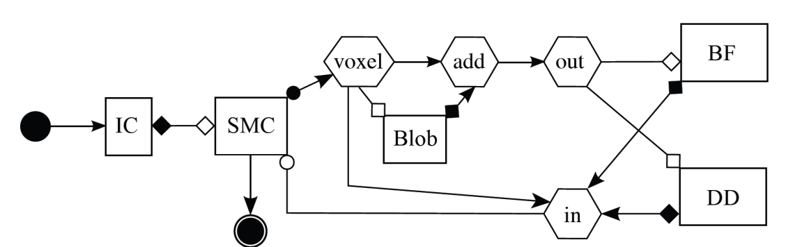
Multiscale Modeling Language and JMML library
MML uniformly describes multiscale models and their computational implementation on abstract level
Textual form (XMML) and graphical form (gMML)
Describes: scale submodules, scaleless mappers and filters and their connection scheme
New MML element that terminates conduit - terminal (a source and a sink).
jMML library handles MML, new features:
outputting MUSCLE configuration file for a given xMML file.
generating a directory structure with preliminary code based on the xMML file.
Example for Instent Restenosis Application
IC – initial conditions
DD- drug diffusion
BF – blood flow
SMC – smooth muscle cells

Slide 28
Evaluation of efficiency
statistics of successful execution of complete multi-scale simulations (Jan –Sep 2013)
the provenance system was used to track execution of individual simulation stages.
users completed 2326 snippet runs which can be interpreted as executions of a single simulation stage.
the GridSpace login operation was performed successfully 1563 times,
users converted their MAD MML designs to GridSpace experiments 232 times,
GridSpace experiments were created (including those based on MML) 553 times

Slide 29
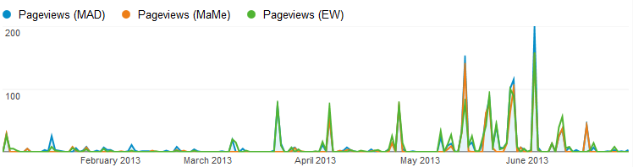
Statistics from monitoring MAPPER web pages
Monitoring using google analytics
Monitoring of web interfaces to the tools, administrator and user manuals and downloads of source codes
Monitoring of page views, unique page views and visits
Tool name | Page Views | Unique Page Views
MAD | 1503 | 700
MaMe | 1000 | 435
GridSpace EW | 1392 | 633
Number of page views for MAD, MaMe and GridSpace EW tools separately (Jan-Sep 2013).

